Slide 1

Robotic Mapping into the Fourth Dimension
Prof. Tom Duckett
Lincoln Centre for Autonomous Systems Research
School of Computer Science
University of Lincoln
Email: tduckett@lincoln.ac.uk

Slide 2
Robotic Mapping into the Fourth Dimension
Introduction
Challenges for Long-Term Mapping
Mapping & Localisation in Static Environments
Mapping & Localisation in Changing Environments
Dynamic maps
Meta-rooms
Frequency mapping
Conclusions

Slide 3
INTRODUCTION

Slide 4
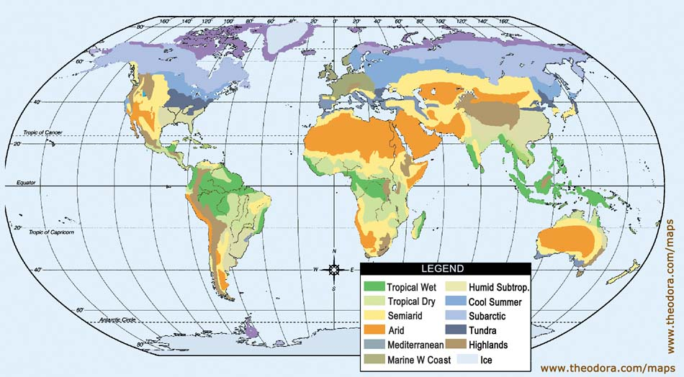
What are maps?
Collection of elements or features at some scale of interest, and a representation of the spatial and semantic relationships among them

Slide 5
Types of Maps
Metric Maps
Record the location of objects in an absolute coordinate system
Topological Maps
Record the connections (links) between a set of places (nodes)
Semantic Maps
Record semantic information (metadata), includes segmentation, place/object naming, function, etc.
Hybrid Maps
Combine two or more of the map types above

Slide 6
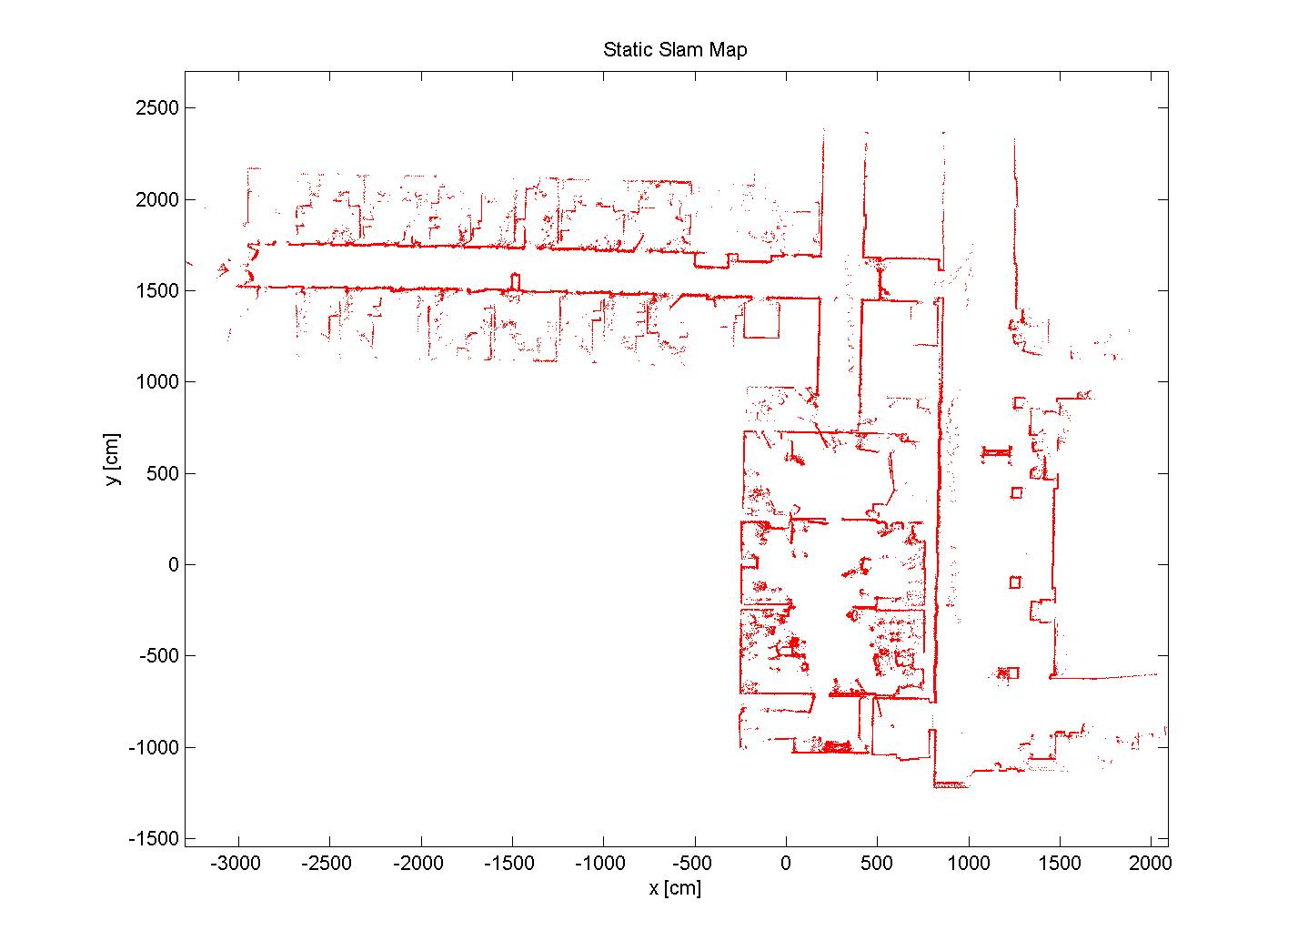
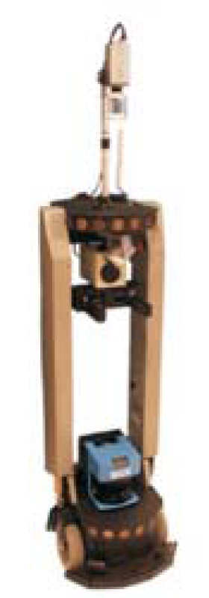
Experimental Results
Staff corridor
Robot lab
Public area
Dynamic Maps for Long-term Operation of Mobile Service Robots Peter Biber and Tom Duckett

Slide 7
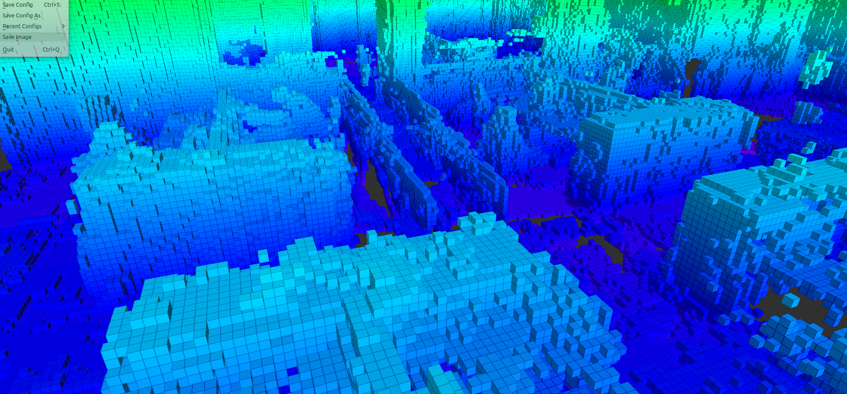
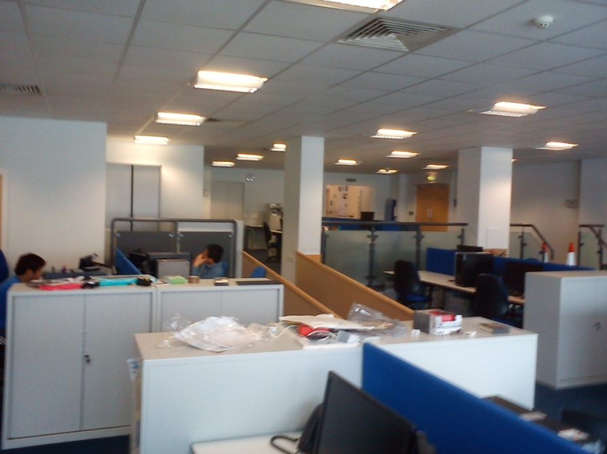

Slide 8
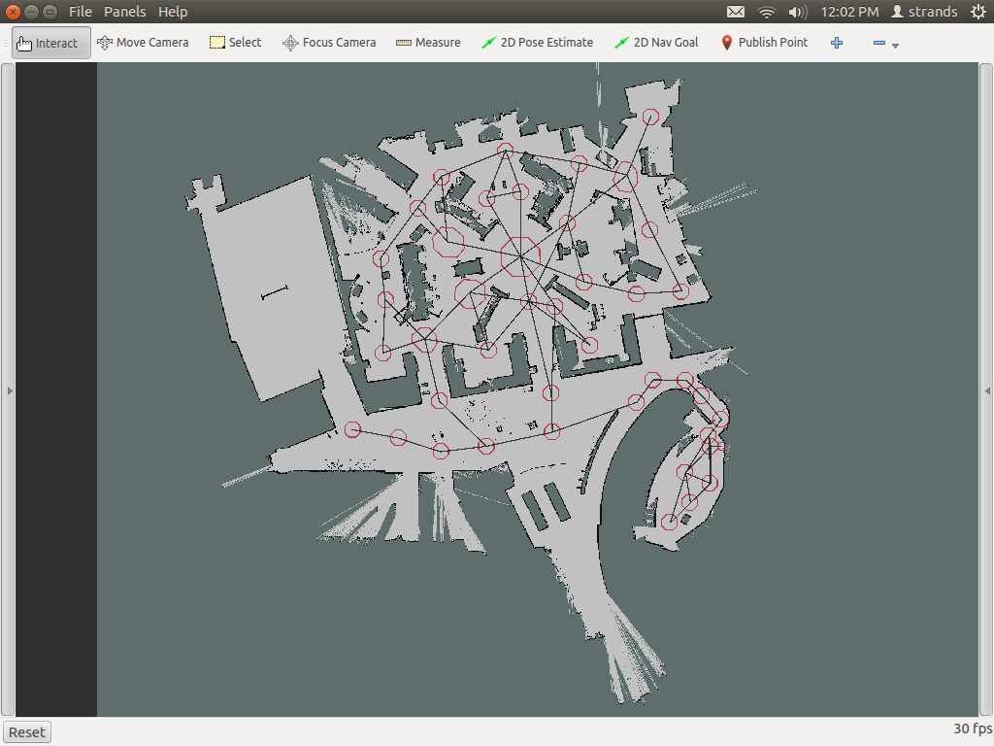
Linda’s navigation map at the Collection Museum, Lincoln

Slide 9
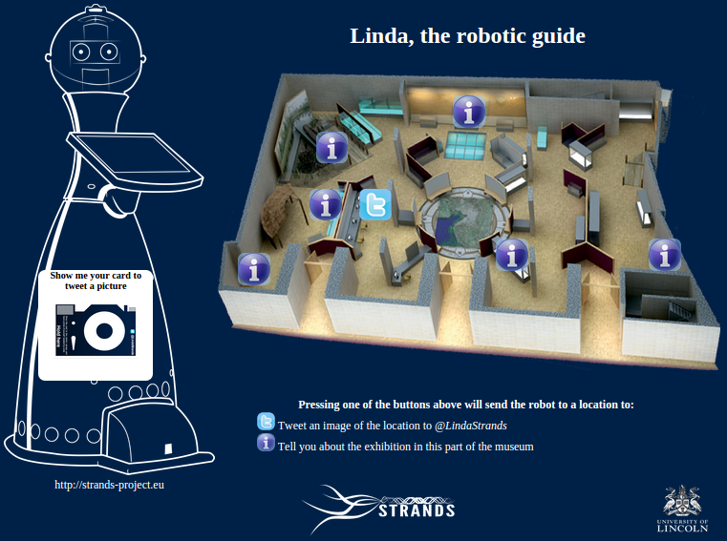
Linda’s touch-screen

Slide 10
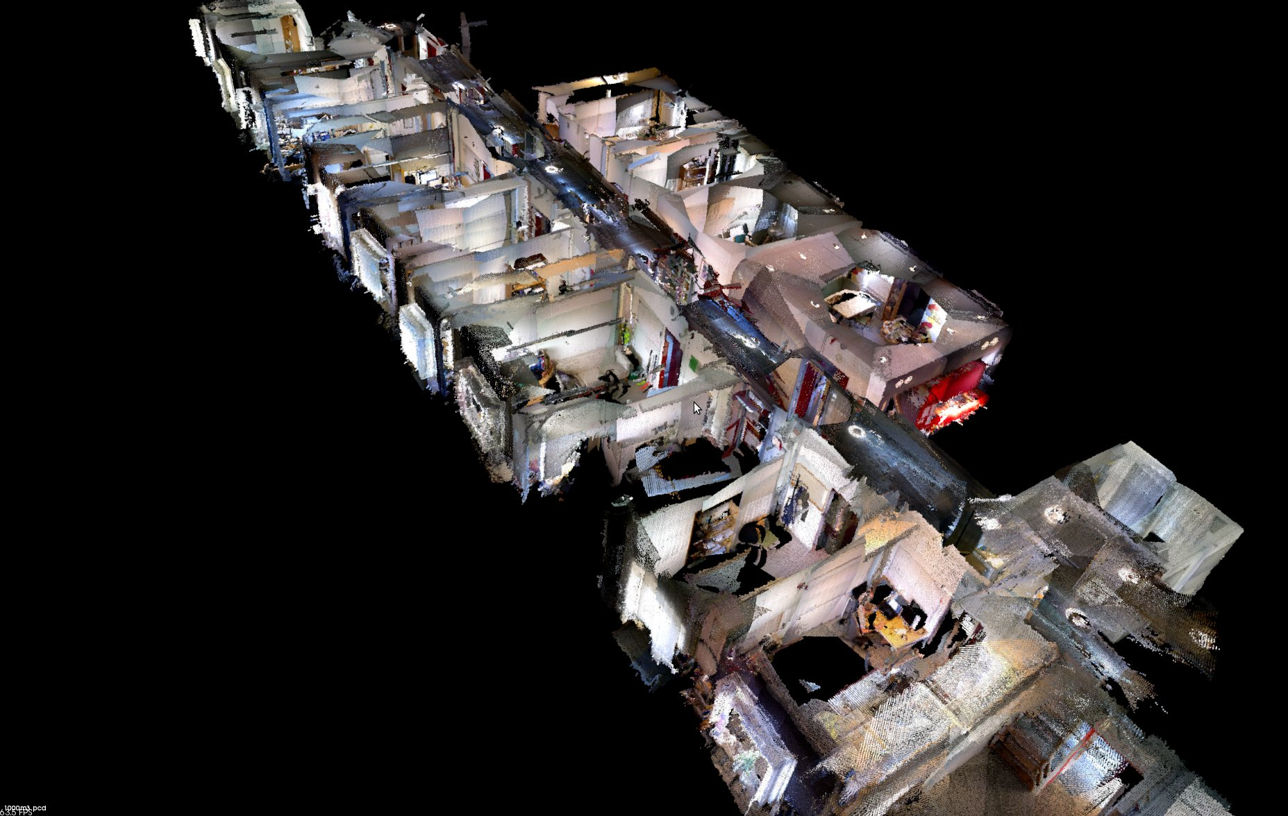

Slide 11
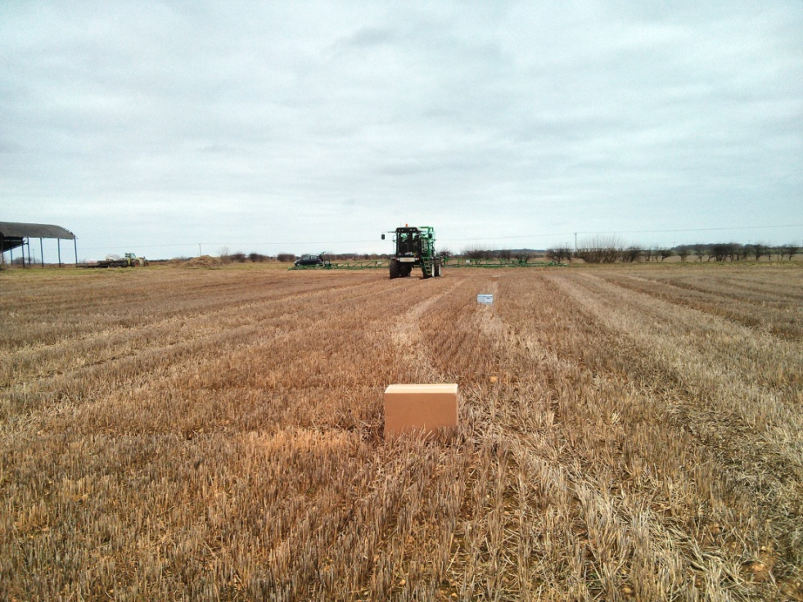
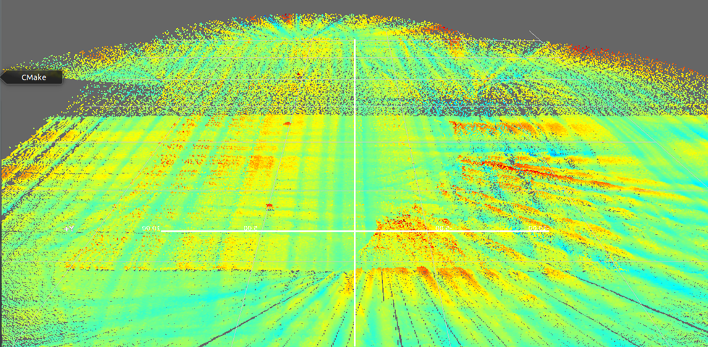
Notes:
And this is the surface built with the laser on the front. As can be seen we could cover the whole field with this only sensor. Here are the boxes. And here in this part the accuracy is not good because here we don’t have 3 GPS but only one (and no inertial at all) so we can’t measure the angles of the vehicle. We just estimate the yaw angle from the positions of the GPS through time and assume that the pitch and roll are zero. So, when the vehicle passes on these irregularities in the terrain and start to shake, we’ve got no way to know that’s happening. So the uncontrolled movement of the vehicle is assumed for the system to be irregularities in the terrain. Nevertheless in the straight paths it seems to work acceptably well.

Slide 12
Robot Maps
Global map
topological
metric
Local maps
e.g. defined at level of a “room”, “field”, etc.
background model + a set of objects that can move + human activities + ...
Semantics, functional regions, dynamics, ...
Knowledge representation for higher-level reasoning and planning

Slide 13
Long-Term Robotic Mapping
Challenges for service robots:
Long-term operation
Large-scale dynamic environments
Live together with people
Consequences for mapping and localisation:
Coping with dynamic and changing environments
Life-long learning and adaptation

Slide 14
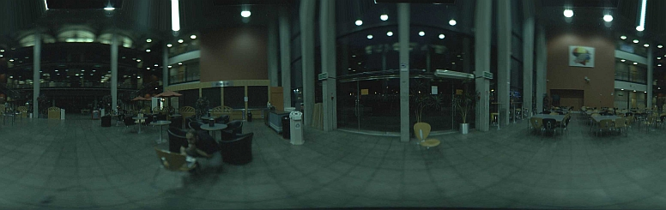
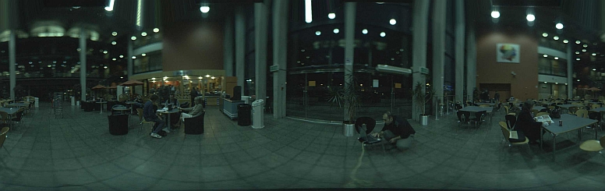
Dynamic Environments
Notes:
As we can see here a two views taken from the same location, as you can see the changes.
A naive solution to this problem would be simply to replace the image representation for each node in the topological map from time to time. Provided that the robot is correctly localized, this approach would enable the robot to remove out-of-date information from the map. However, it could also remove useful features due to temporary occlusions, and could lead to catastrophic results in the case of localisation errors. A better solution would be to update the image representation of a node incrementally.

Slide 15
Mapping & Localisation in Static Environments

Slide 16
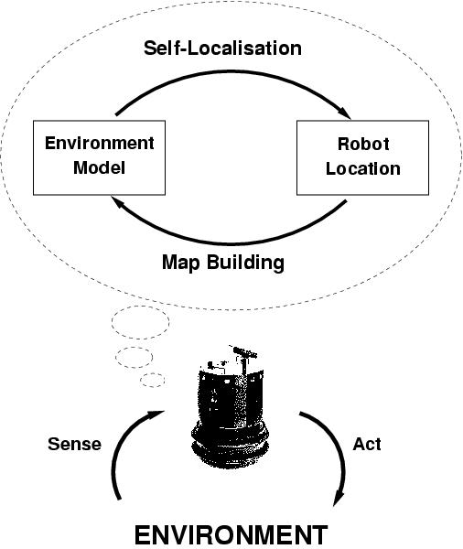
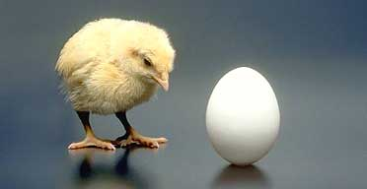
Localization and Mapping
SLAM = Simultaneous Localisation and Mapping
Map
Location
A “chicken and egg” problem!

Slide 17
Probabilistic Robotics
Explicit representation of uncertainty using the calculus of probability theory
S. Thrun, W. Burgard, and D. Fox, Probabilistic Robotics. MIT Press, 2005.

Slide 18
Markov Assumption
Markov assumption: past and future data are independent if one knows the current state x_{t}
“Static world”

Slide 19
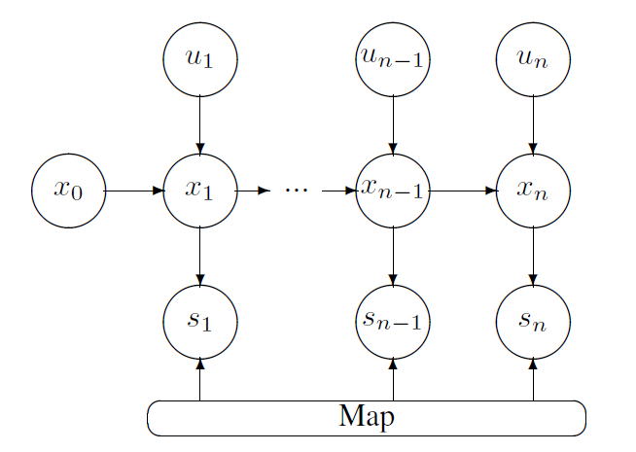
Markov Localization

Slide 20
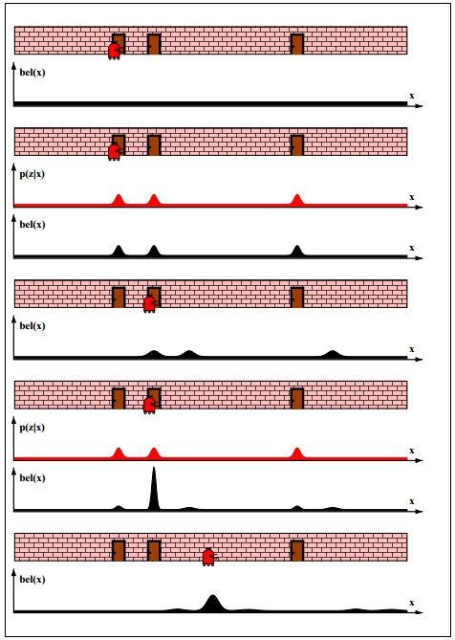
Markov Localization

Slide 21

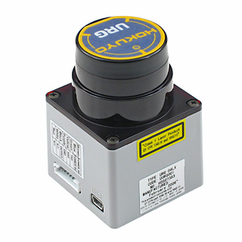
Localization and Mapping
Example of automatic mapping (no SLAM)

Slide 22

Localization and Mapping
Example of automatic mapping (with SLAM)

Slide 23

Data Association
Which parts of the current observation correspond to which parts of the map?
e.g. “loop closing” problem in SLAM
START

Slide 24
Mapping & Localisation in CHANGING Environments – Approach 1: DyNAMIC map

Slide 25
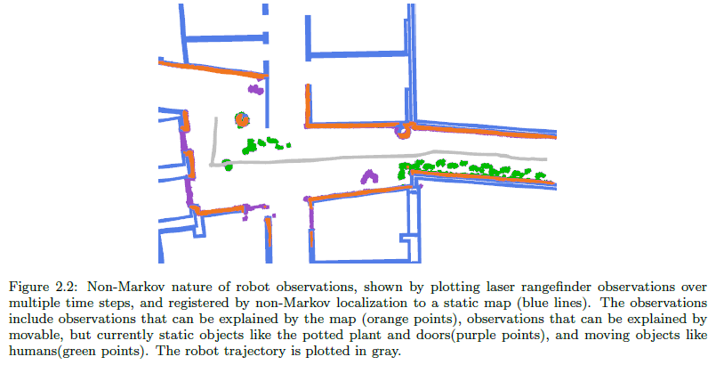
Varying Environments
J. Biswas, Hybrid Markov / Non-Markov Localization for Long-Term Autonomy of Mobile Robots in Varying Indoor Environments. PhD Thesis Proposal, Carnegie Mellon University, 2013.

Slide 26

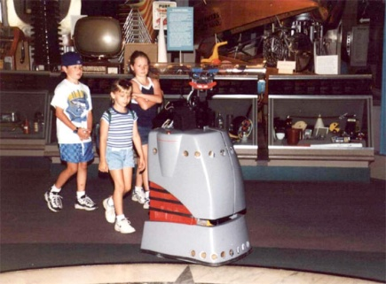
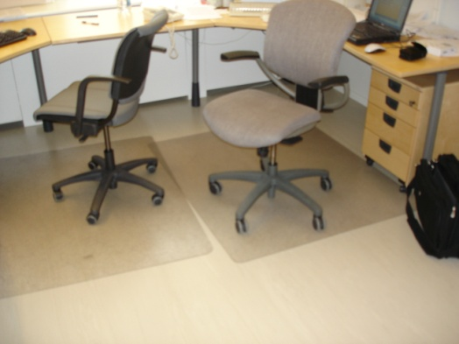
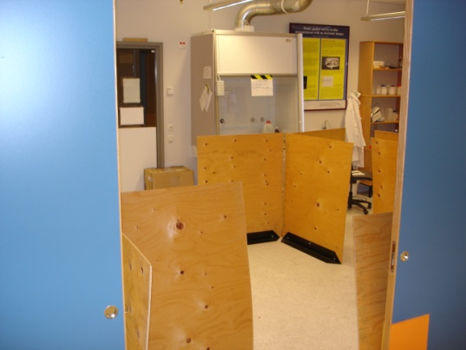
Varying + Changing Environments
Moving people or robots
Movable objects (tables, chairs)
Temporary objects (packages)
Gradual changes (plants grow)
Abrupt change (a new wall is built)

Slide 27
The Stability-Plasticity Dilemma
Life-long learning requires:
Adaptation to new patterns, and
Preservation of old patterns
Stability
Plasticity
Robot motion
Lasting changes
Transient changes
Biber, Peter and Duckett, Tom (2009) Experimental analysis of sample-based maps for long-term SLAM. International Journal of Robotics Research, 28 (1).

Slide 28
Toy Example
Room
Cupboard
Distance d
Simple map:
Only entry is distance d

Slide 29
Approaches to dynamic mapping
Mean distance (Running average):
Not well suited.
The time that the map needs for adapting to a change should not be dependent on how much time has been passed in absolute terms.

Slide 30
Approaches to dynamic mapping
Recency weighted averaging
Measurement has an age t
Observation: The law that governs the update of a dynamic map is inherently dependent on a time scale parameter.

Slide 31
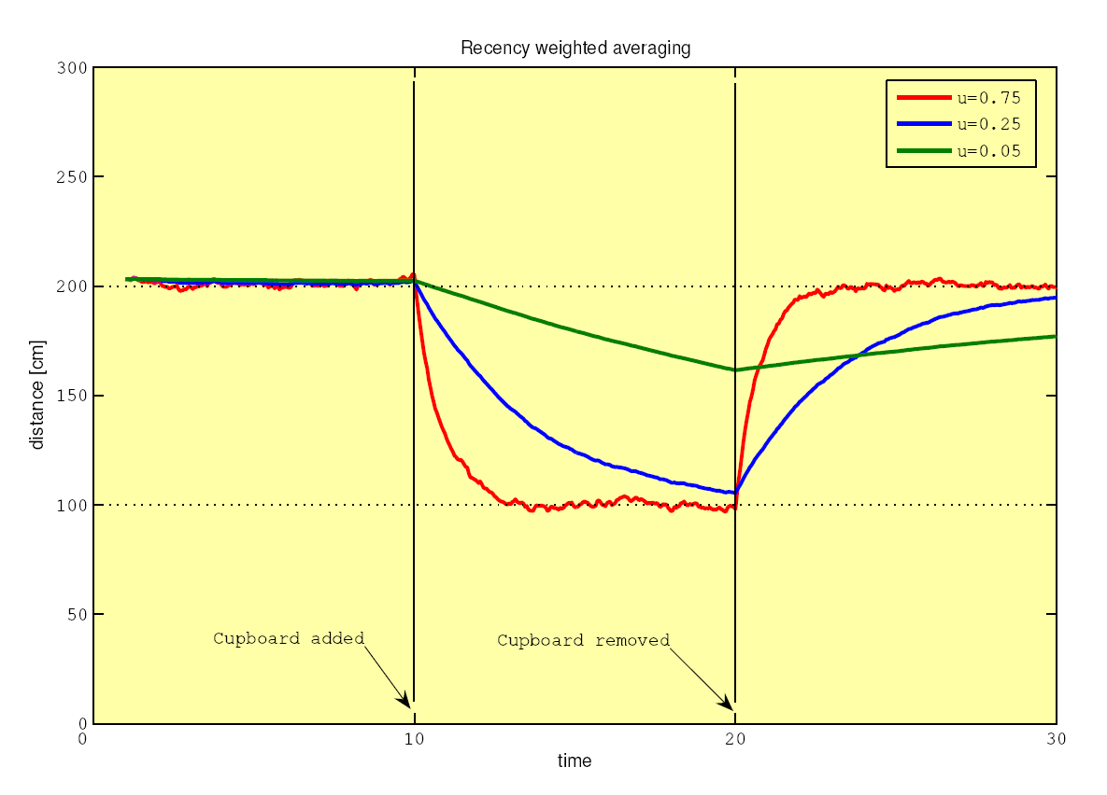
Simulation of the toy example

Slide 32
Approaches to dynamic mapping
Problems of recency weighted averaging:
Cannot handle non-continuous changes
Not robust against outliers
Cannot maintain multiple hypotheses
Dynamic map should give distance to wall or to cupboard but nothing inbetween

Slide 33
The problem of outliers
Notorious problem in Least-Squares formulations (classical statistics)
Outlier declaration is not possible directly after the measurement!
Unexpected sensor reading:
Might be an outlier
Might be a change
Can only be said after more sensor readings, and depends also on the timescale.
Must maintain both hypotheses

Slide 34
Our solution (part 1)
Representation of measurements by a set of samples
Interpretation of samples by robust statistics (median and MAD)
Update dynamic map by replacing samples
Can maintain multiple hypotheses
Robust against outliers
Estimates are only values that have actually been measured

Slide 35
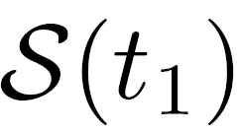
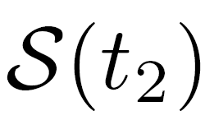

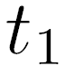
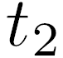
Update of a sample set
Samples
Measurements
Number of samples n = constant
Replacement determined by update ratio 0 < u < 1:
Remove n*u randomly chosen samples from
Add n*u randomly chosen samples from

Slide 36
Semantics of a sample set
Probability that a sample is t time steps old:
Age of samples is distributed like the weights in recency weighted averaging:

Slide 37
Semantics of a sample set

Slide 38
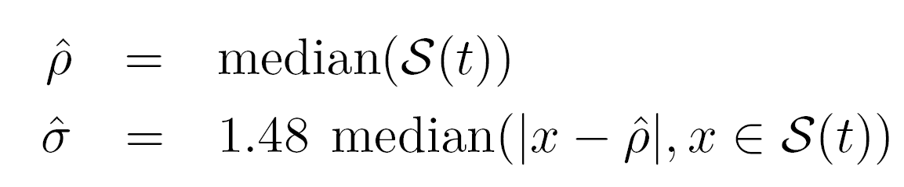
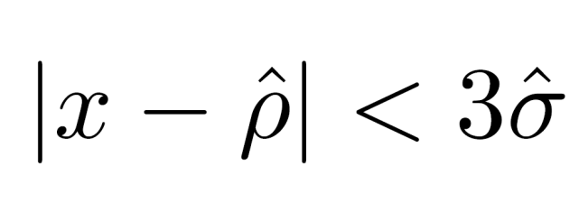
Probabilistic interpretation
Estimate parameters of Gaussian using robust statistics (Median and MAD)
Outlier ratio: sample considered inlier, if
otherwise outlier (99.7% confidence level)

Slide 39
Our solution (part 2)
There is no single “correct” timescale (stability-plasticity dilemma)
Maintain map simultaneously at multiple timescales (5 in our experiments)
Stability
Plasticity

Slide 40
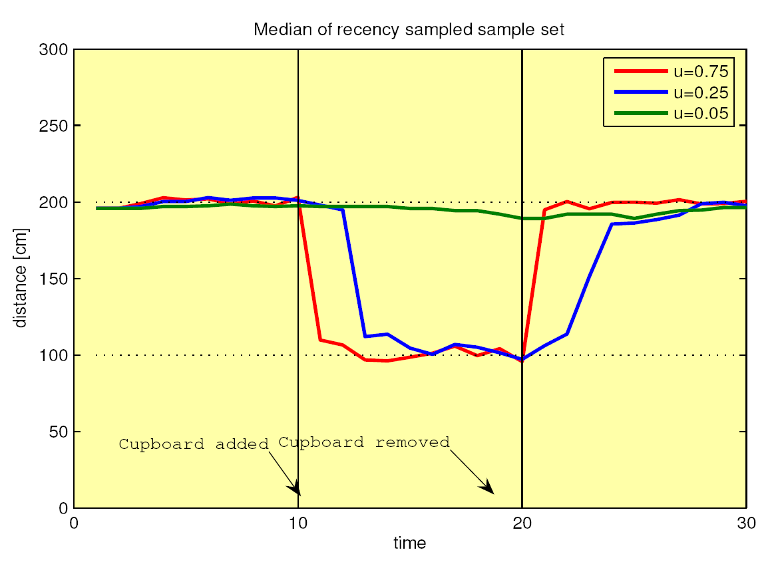
Simulation of the toy example
Sample-based map
Recency weighted average

Slide 41
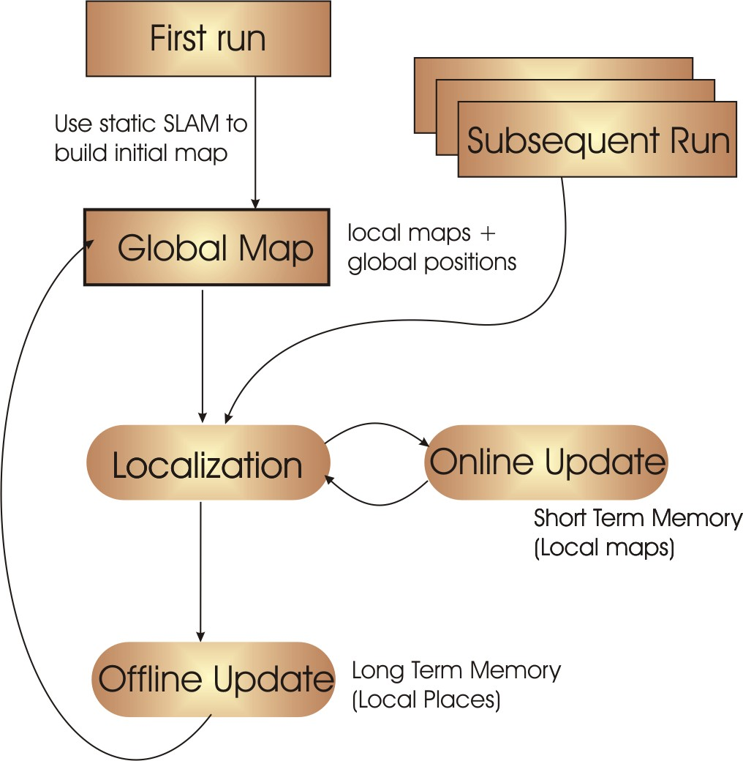
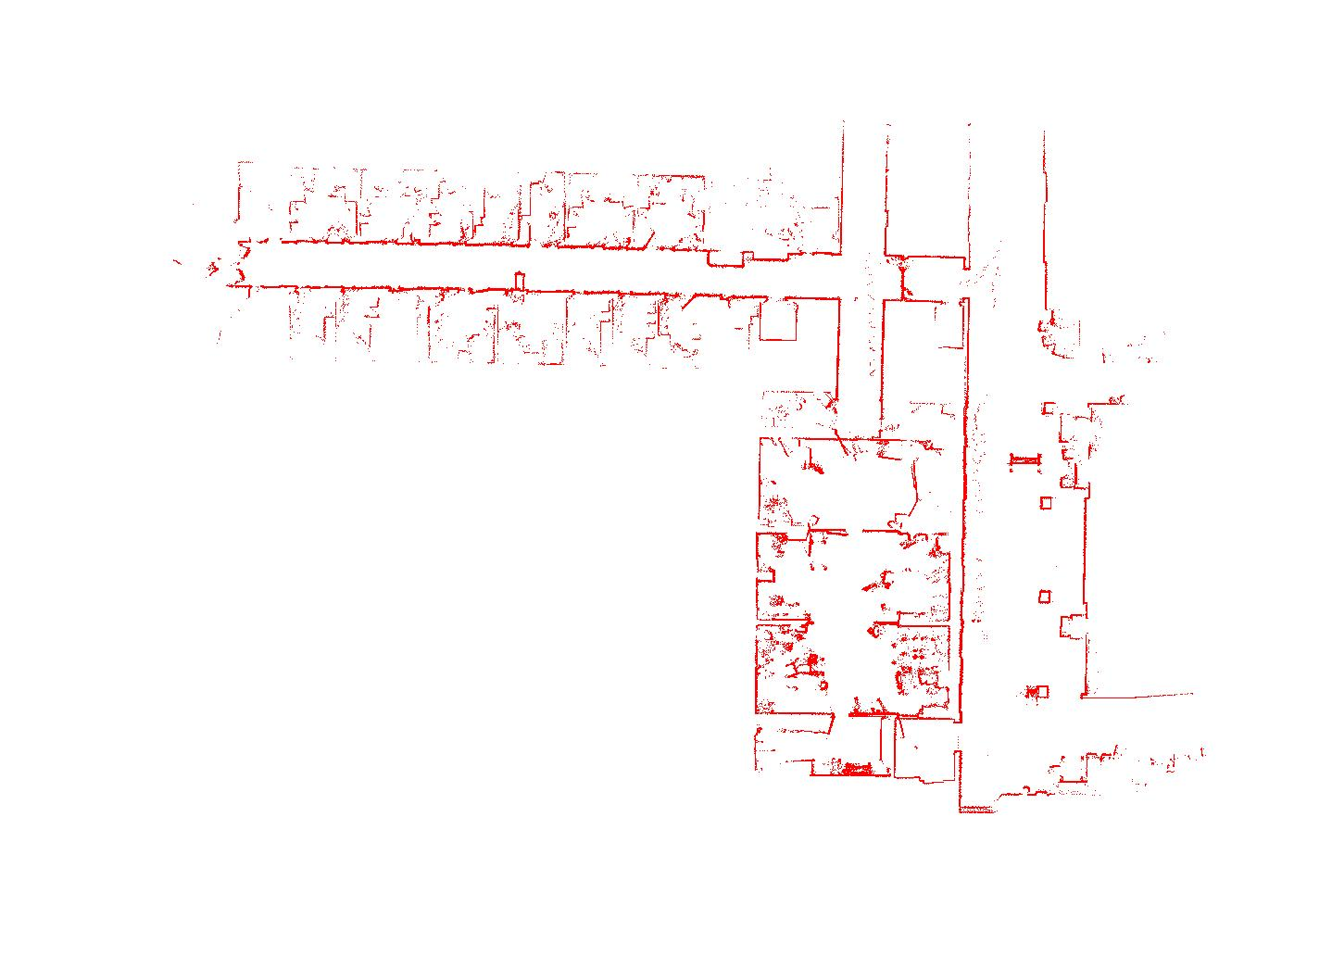
A complete system for lifelong mapping and localization
Initial static SLAM map

Slide 42
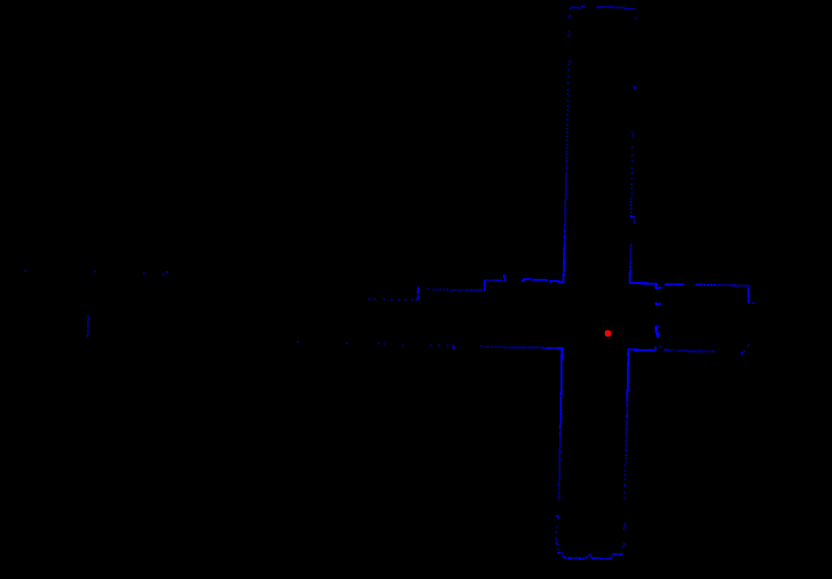
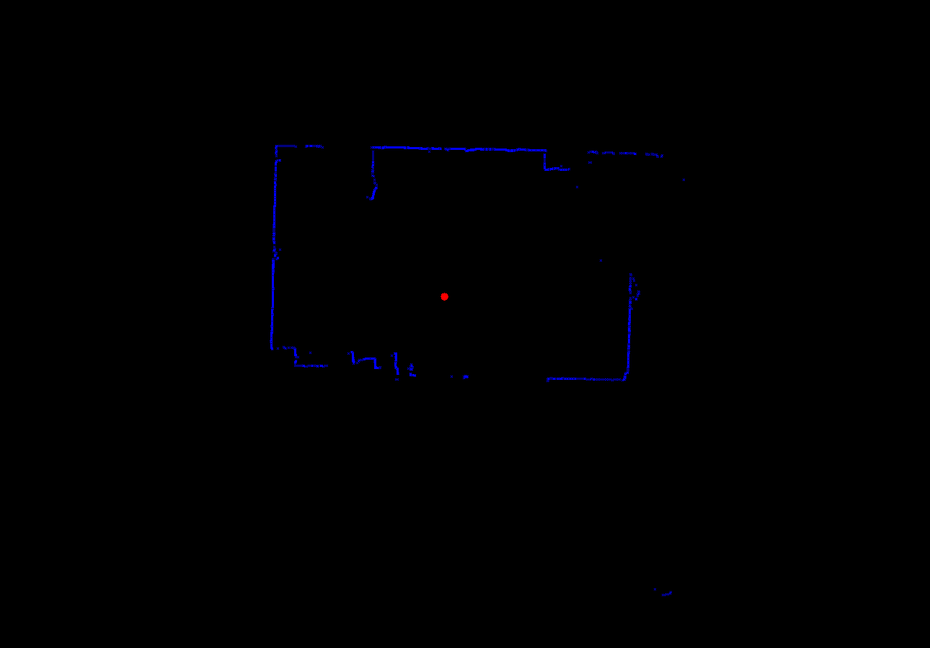
Local Maps
Robot lab
Corridor junction
Observations (laser scans) are projected into the same local coordinate system before updates

Slide 43
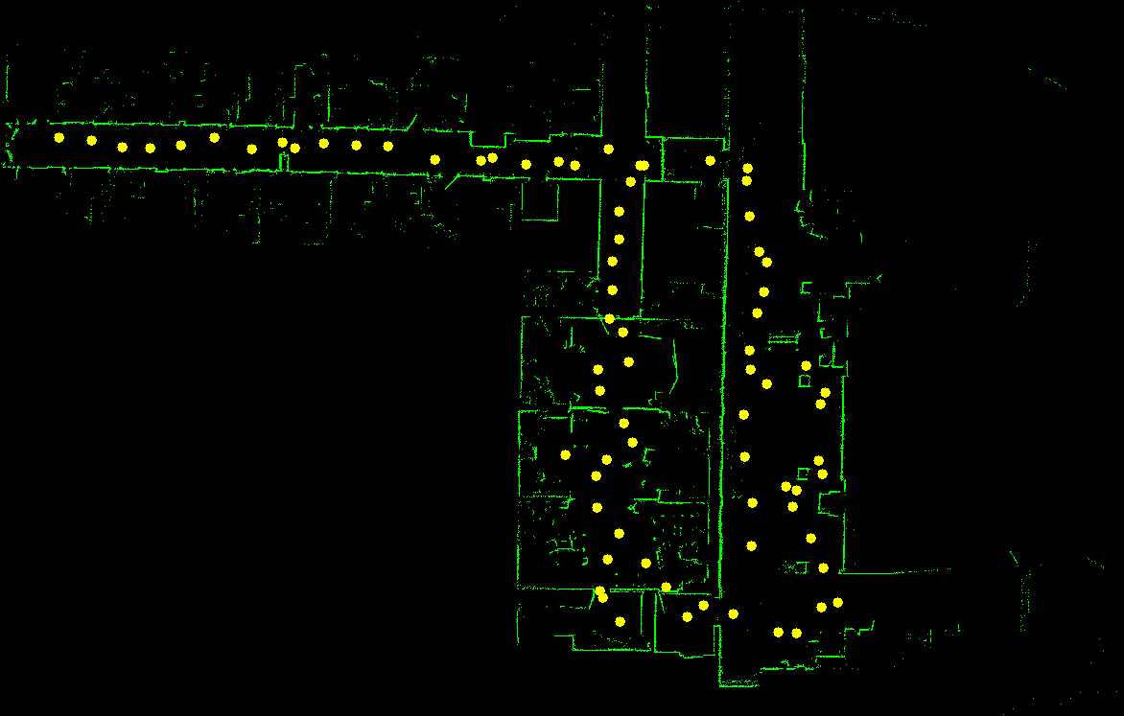
Local Maps
Initial set of 76 local maps
Selected from first run using heuristics
More added online as needed

Slide 44
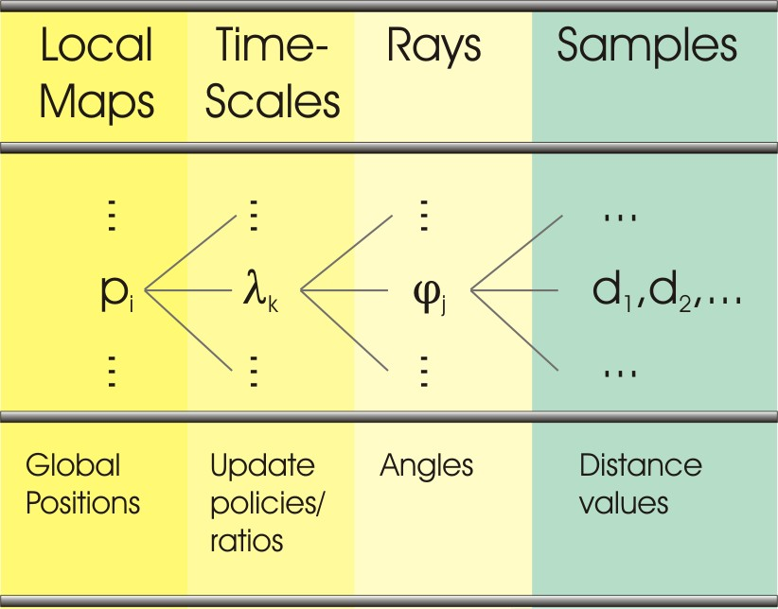
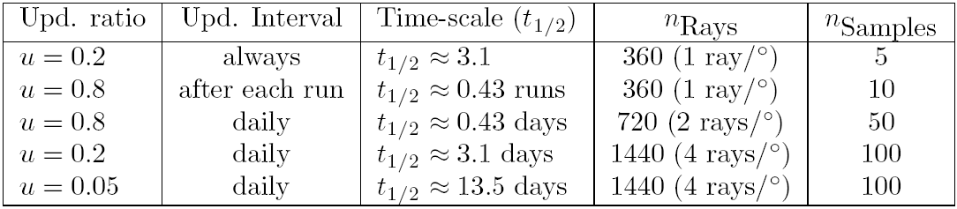
Local Maps
5 timescales
Online update (STM)
Offline update (LTM)

Slide 45
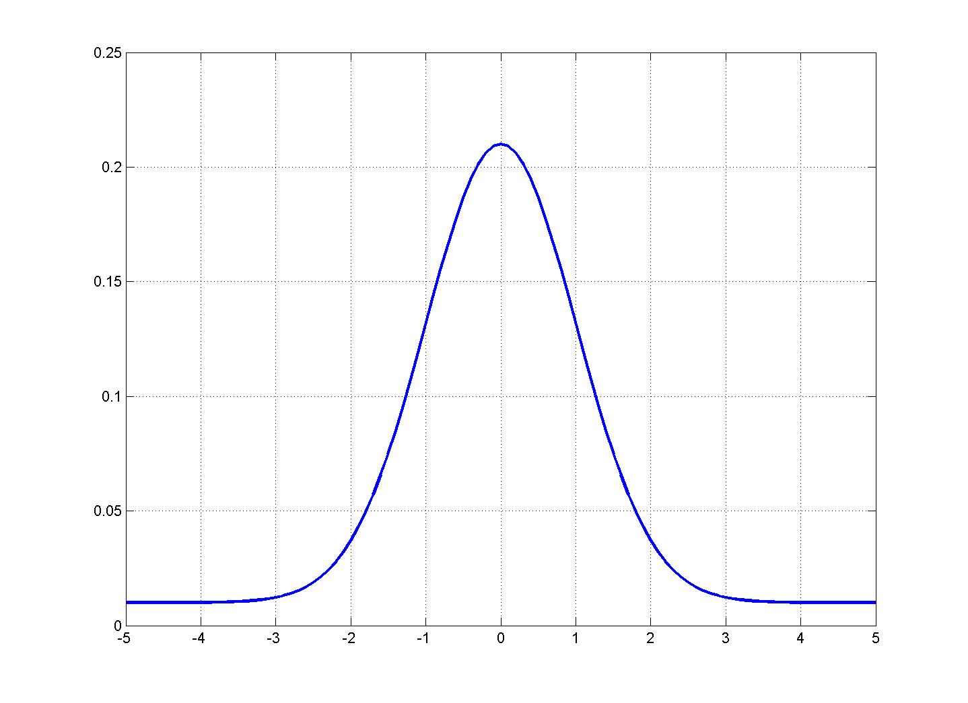
Perceptual model for local map selection
Probability of a measuring a range value given
a local map
a time-scale
a time t
Mixture model: Gaussian + Outlier

Slide 46
Self-localization (position tracking)
Current Map is defined according to:
Local maps
Current position estimate
Sensor input
and is built on-the-fly when needed
Selection of the time-scale in a local map is data-driven (choose the time-scale that best fits the data)

Slide 47
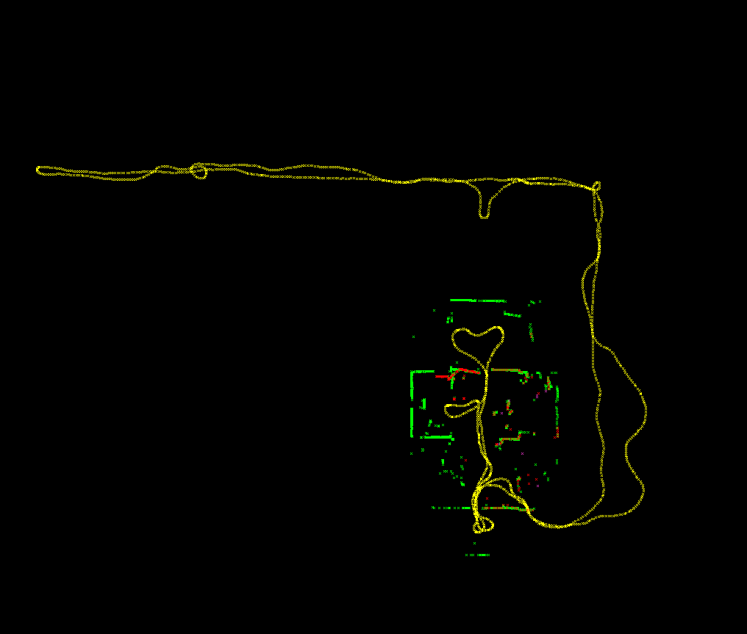
Self-localization (position tracking)
Current Map: Green
Current Scan: Red
Trajectory: Yellow
Scan Matching using odometry as prior: Next Scan vs. Current Map

Slide 48
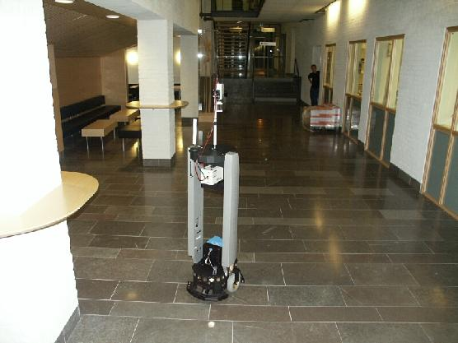
Experiments
5 weeks (23 days)
75 runs (~3 per day)
~100 000 scans
~9.6 km
Robot steered manually

Slide 49
Experimental Results
Staff corridor
Robot lab
Public area

Slide 50
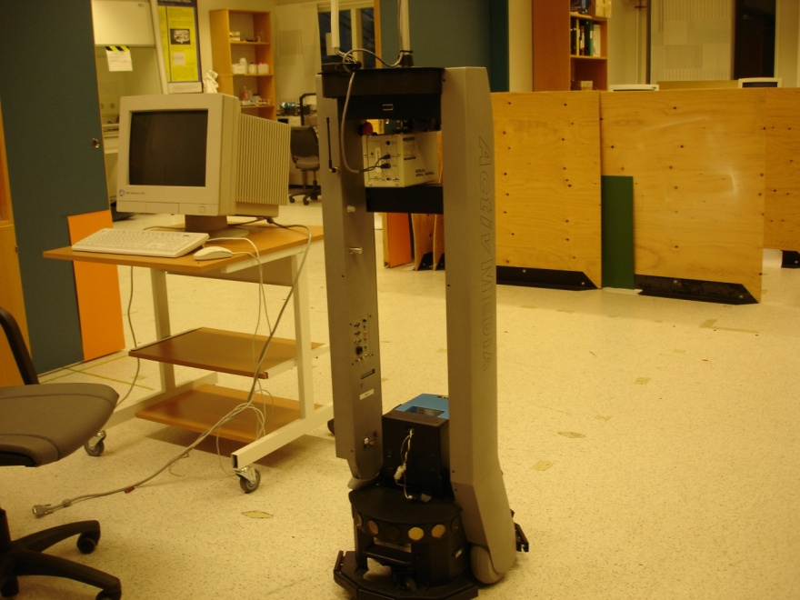
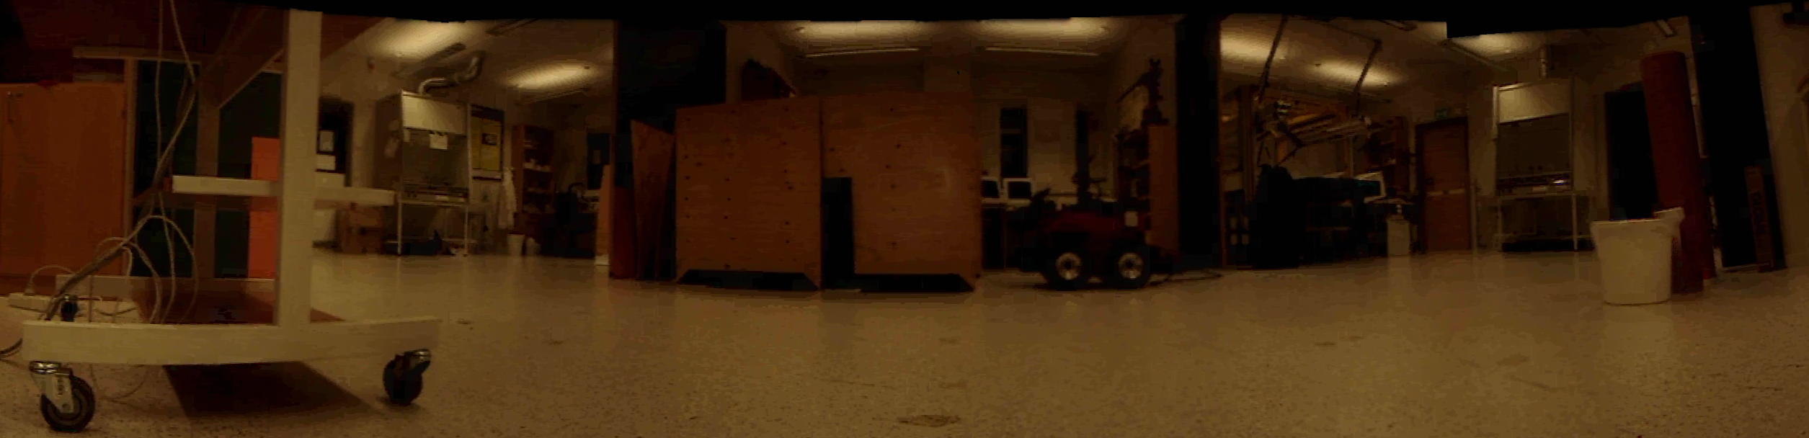
Experiments
Example of a dynamic environment (AASS robotics lab, Örebro)

Slide 51
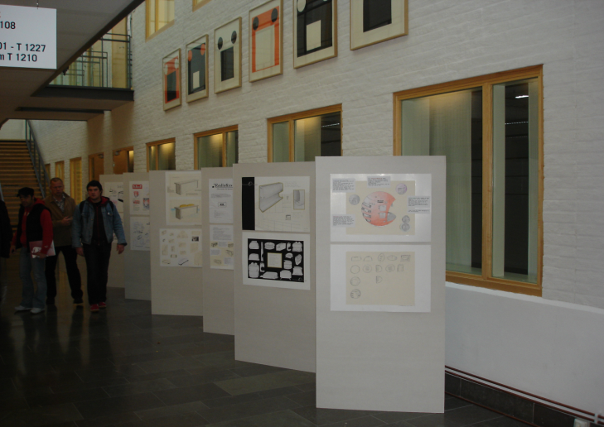
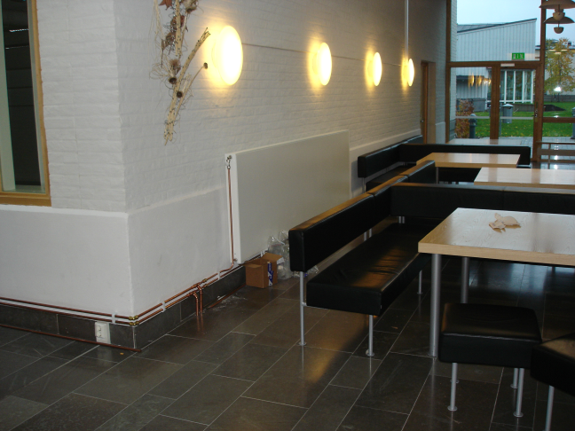
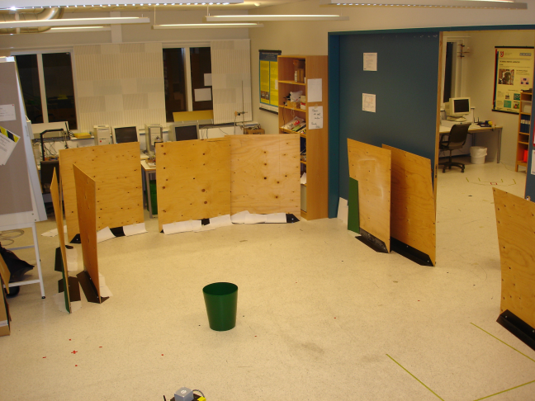
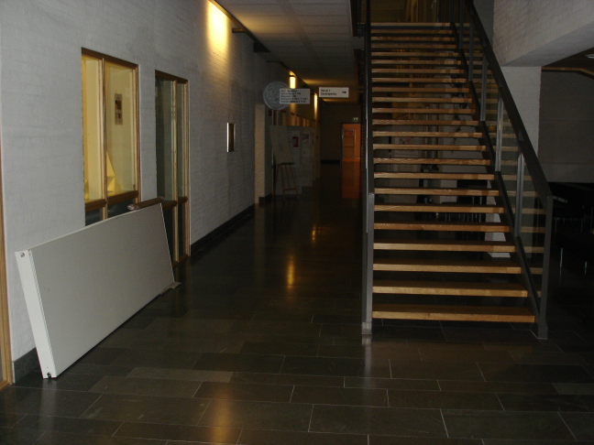
Experiments

Slide 52
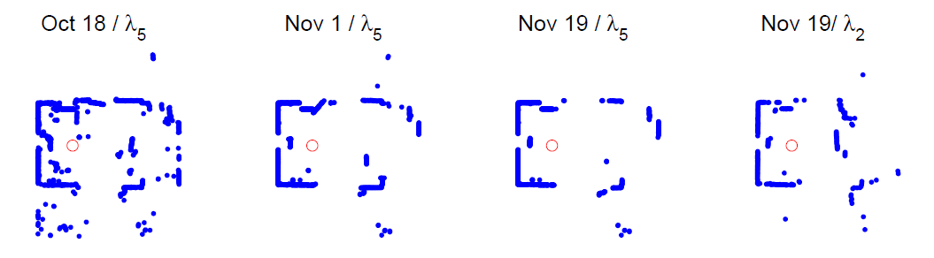
Results
Accuracy of maps increases with time
Static parts like walls emerge, while moving objects disappear from long-term maps

Slide 53

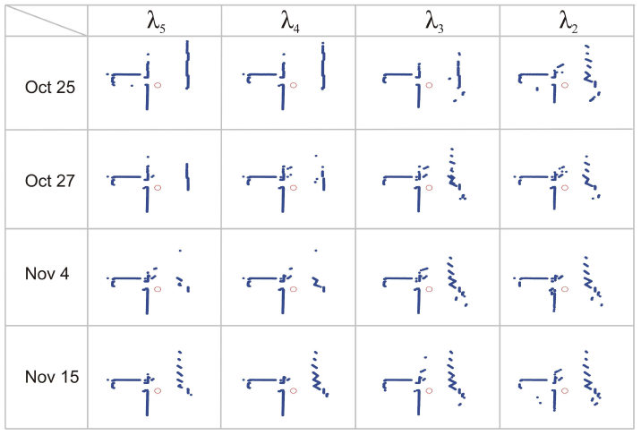
Results

Slide 54
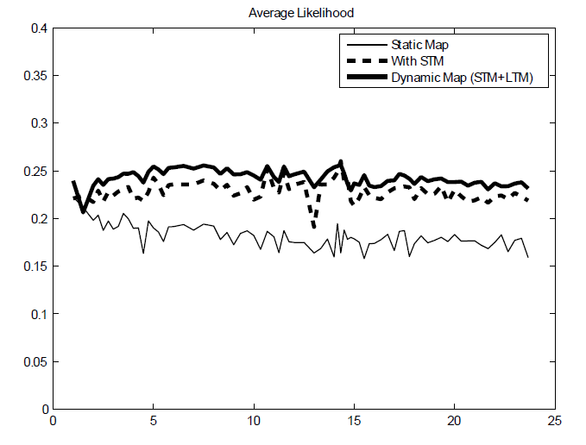
Results
Average likelihood of a range measurement
Likelihood
Days

Slide 55
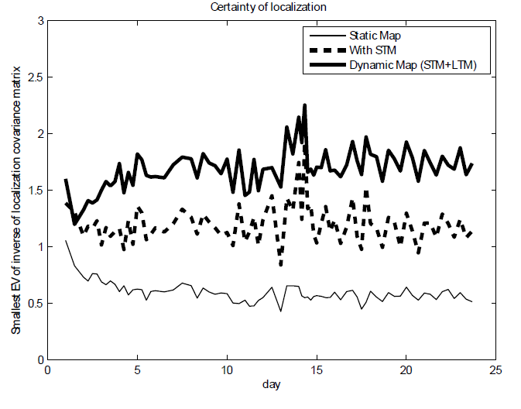
Results
Certainty of the localization estimate

Slide 56
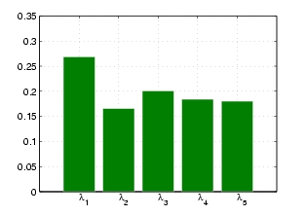

Relative frequency of submap usage
All long-term maps are used with similar frequency, short-term map is used more often
But with time, longest-term map is used more, short-term map is used less
Notes:
More samples -> median filter gets more precise

Slide 57
Conclusions
Static SLAM:
One-shot learning or averaging without forgetting
“First impression lasts forever“
Dynamic Mapping:
Robot never stops learning (and forgetting!)
Beginning of time has no special status

Slide 58
Conclusions
Outlier vs. change?
Need to store both hypothesis
Our solution: dynamic sample sets interpreted using robust statistics
Stability-plasticity dilemma
Our solution: learning across multiple timescales
Segmentation-free approach
No need to classify “static” vs “dynamic” parts

Slide 59
Conclusions
“Exploitation vs. Exploration”
LTM: robustly use what you know already
STM: switch to “SLAM” if the world has changed
Take care with datasets and simulations!
Offline experiments have a start and end time
vs. Lifelong adaptation

Slide 60
Limitations
Memory requirements
Over 300,000 samples per local map
60MB in total
How to determine the timescale parameters?
Long-term topological changes not considered

